Slide 1
Inertial Navigation
Lewis Collum

Slide 2
Orientation
Common computer graphics method to rotating objects

Slide 3
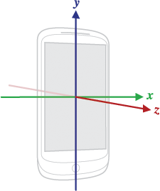
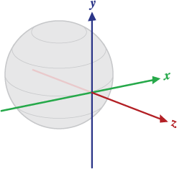
Global Acceleration from Local acceleration & orientation
Local acceleration along these axes
Global acceleration along these axes
Must account for orientation

Slide 4
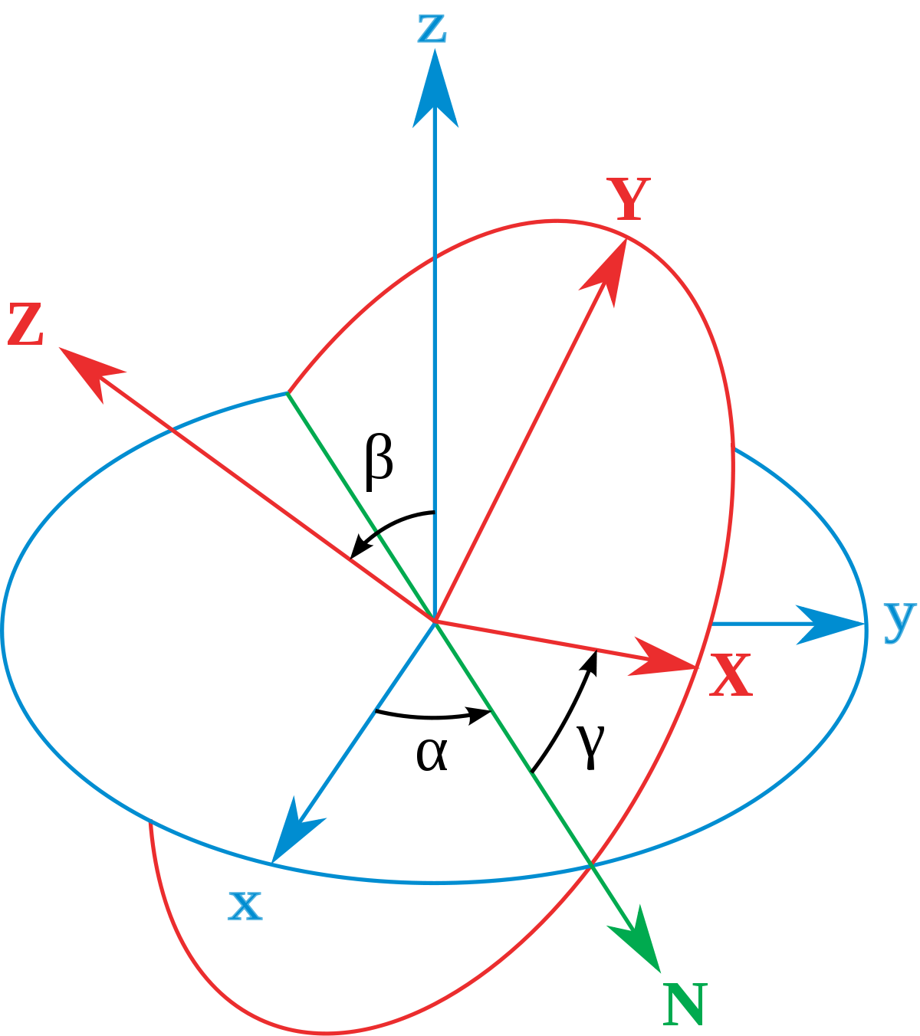
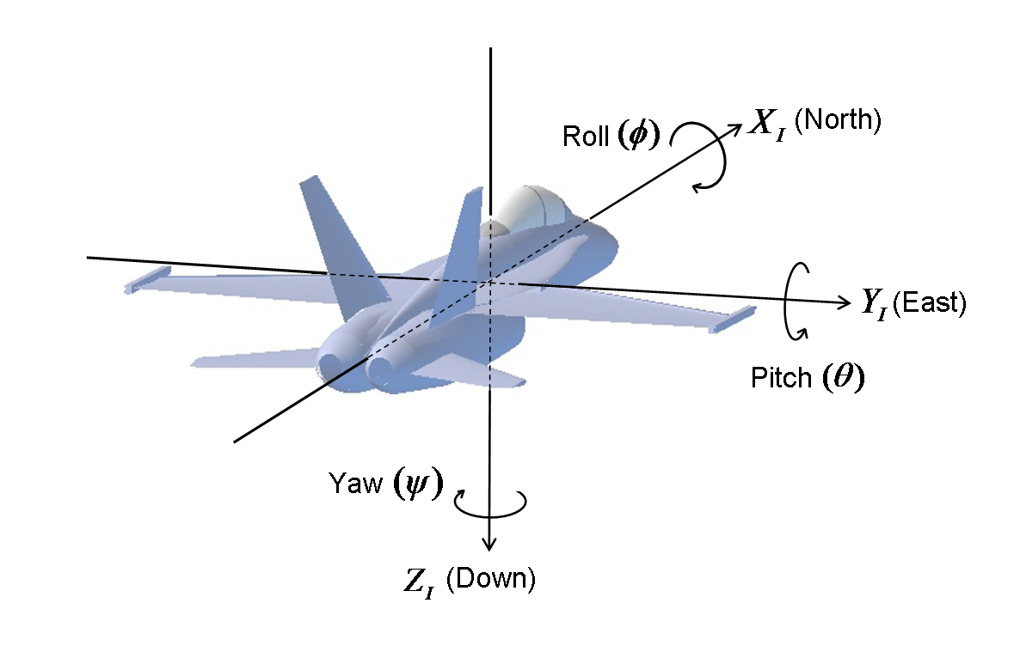
Euler Angles gimbal lock & mathematical complexity
Represented by 3 angles: ROLL, PITCH & YAW
Gimbal Lock occurs when two axes align
Algebraic nuisance in code

Slide 5
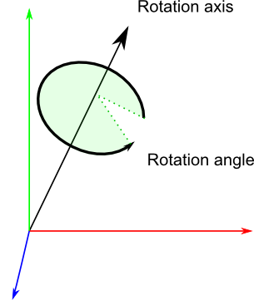

Axis-Angle Representation visually intuitive, ALGEBRAICALLY not
4D representation of 3D rotations
Rotation Axis: (vector) $=[ x, y, z ]$
Rotation Angle: (scalar) $=θ$
Applying rotation is not intuitive

Slide 6

Quaternions ALGEBRAICALLY intuitive, visually not
4D representation of 3D rotations
Rotation Axis: (vector) $=[ x, y, z ]$
Rotation Angle: (scalar) $=w$
Easily interpolated

Slide 7



Converting Axis-Angle to Quaternion
Rotation Axis: (vector) $=[ x, y, z ]$
Rotation Angle: (scalar) $=θ$
$$w=\cos\left(\frac{θ}{2}\right)$$
$$x=x∙\sin\left(\frac{θ}{2}\right)$$
$$y=y∙\sin\left(\frac{θ}{2}\right)$$
$$z=z∙\sin\left(\frac{θ}{2}\right)$$
Rotation Axis: (vector) $=[ x, y, z ]$
Rotation Angle: (scalar) $=w$

Slide 8
Class for Quaternions
Code in python

Slide 9
Constructor storing the four-dimensional Quaternion
class Quaternion:
def __init__(self, vector = tuple([0, 0, 0]), scalar = 0):
self.vector = vector
self.scalar = scalar
...

Slide 10

Hamilton Product Overloading multiplication operator
def __mul__(self, other):
b1, c1, d1 = self.vector
a1 = self.scalar
b2, c2, d2 = other.vector
a2 = other.scalar
w = a1*a2 - b1*b2 - c1*c2 - d1*d2
x = a1*b2 + b1*a2 + c1*d2 - d1*c2
y = a1*c2 - b1*d2 + c1*a2 + d1*b2
z = a1*d2 + b1*c2 - c1*b2 + d1*a2
return Quaternion(tuple([x, y, z]), w)
From Wikipedia

Slide 11

Conjugating a vector by a quaternion rotating a vector Using a Quaternion
def applyToVector(self, vector):
quaternionFromVector = Quaternion(vector, 0.0)
resultantQuaternion = self * quaternionFromVector * self.conjugate()
return resultantQuaternion.vector
From Wikipedia
Notice: This is the Hamiltonian Product

Slide 12
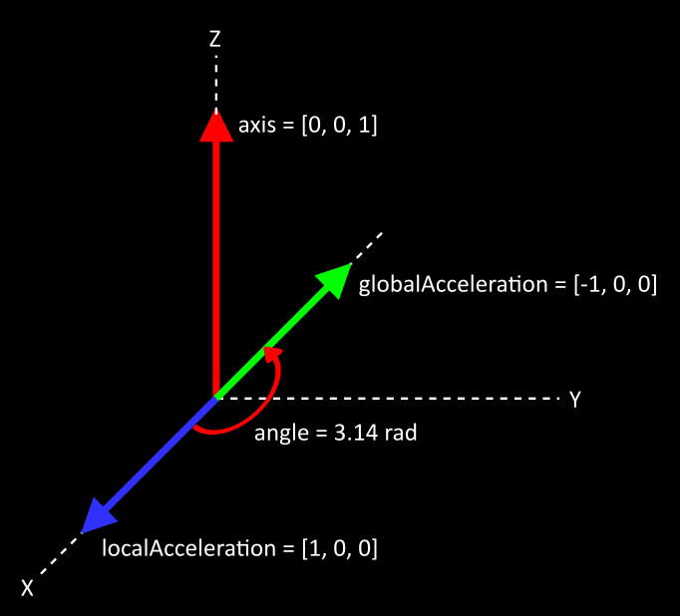
Class Usage finding global acceleration

Slide 13

Class Usage finding global acceleration
localAcceleration = tuple([1, 0, 0])
axisAngle = AxisAngle([0, 0, 1], 3.14159265)
quaternion = axisAngle.toQuaternion()
globalAcceleration = quaternion.applyToVector(localAcceleration)
...
Out: (-1.0, 3.5897930298416118e-09, 0.0)
$$≈0.0$$

Slide 14
Segmented Average
Synchronization of sensor data

Slide 15
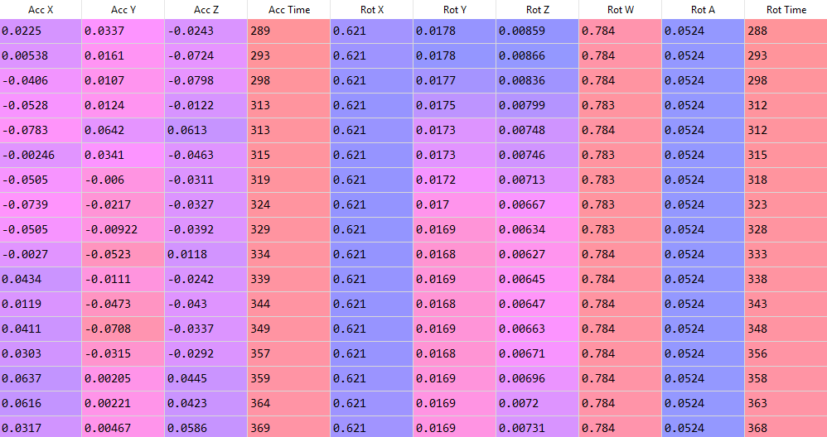
Sensor Data asynchronous collection
Linear Acceleration
milliseconds
Quaternion (Rotation)
milliseconds

Slide 16
Design of Segment Set
Center
Center
Center
Cap
Cap
Cap
Cap
array
0 1 2 3 4 5 6

Slide 17
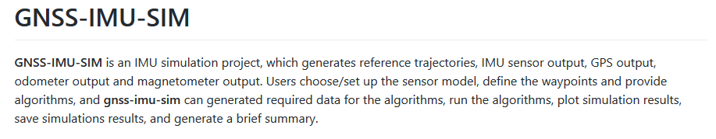
Testing phone data accuracy

Slide 18
Problems
Potential issue with phone data
Drift (from low frequency effects)

Slide 19
Good news
Segment Set works
Segmented Average is no longer buggy
Orientation is working properly

